Slide 1
North Wales Region
www.llaiswales.org

Slide 2
Presenting today
Geoff Ryall-Harvey
Regional Director – North Wales
www.llaiswales.org
Notes:
Introduce yourself, your background and how and why you got involved with Llias.
Explain what will be covered today:
What, who and how….

Slide 3
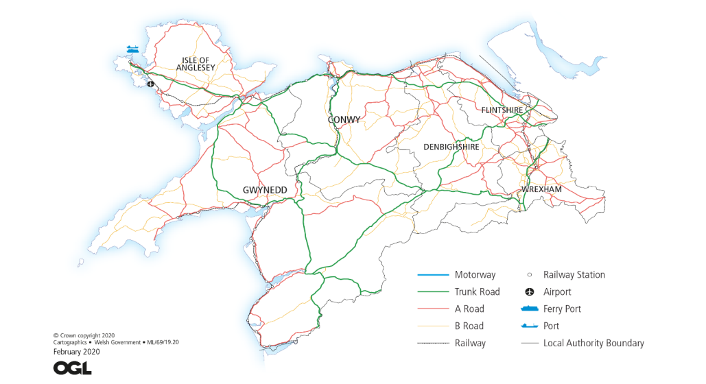
North Wales Region has offices in Bangor and Wrecsam. Distances are long in North Wales; 150 miles round trip between the two offices. From Holyhead in the North to Ellesmere on the Shropshire border is 115 miles.
Notes:
Staff – CHC staff transferring over plus more staff to help support an expanded remit across health and social care.
Volunteers – people living in and representing local communities

Slide 4
There are 6 local authorities providing social care in North Wales;
Ynys Môn
Conwy
Gwynedd
Flintshire
Denbighshire
Wrecsam
Populations vary from 155,000 in Flintshire to 70,000 in Ynys Môn – total population is around 730,000.
Notes:
Reference to the legal name.. ‘you may know us by another name’… Citizen Voice Body for Health and Social Services Wales. Explain our operational name will be Llais, ties to our Welsh identity and reflects our more modern, relatable and less formal approach.

Slide 5
Betsi Cadwaladr University Health Board is the largest health organisation in Wales, with a budget of £1.87 billion and a workforce of over 19,000. The Health Board is responsible for the delivery of health care services to nearly 3/4 M people across the six counties of North Wales.
There are 3 District General Hospitals and 15 Community Hospitals. The Health Board coordinates the work of 96 GP practices, and NHS services provided by 83 dental and orthodontic practices, 69 optometry practices and opticians and 147 pharmacies in North Wales.
Notes:
Reference to the legal name.. ‘you may know us by another name’… Citizen Voice Body for Health and Social Services Wales. Explain our operational name will be Llais, ties to our Welsh identity and reflects our more modern, relatable and less formal approach.

Slide 6
Special Measures
BCUHB spent 5 years in Special Measures and were returned in March 2023 by Welsh Government in relation to the areas of concern set out in a report by Audit Wales….
Notes:
Governance and board effectiveness.
Workforce and organisational development
Finance and audit
Compassionate leadership and culture
Clinical governance, patient experience and safety
Operational delivery
Planning and service transformation
The Chair, Vice-Chair and other Independent Board Members were removed by the Minister in March and the Executive Team was criticised. The Executive Team remain in place and the Chair and Independent Board members have been replaced with interim appointments.
Public confidence in BCUHB is very low and has been for over ten years.

Slide 7
Mental health services in North Wales continue to under-perform significantly and, once again, form part of the Special Measures framework…….
Mental Health Services
Notes:
Many of the issues identified in the Ockenden, HASCAS and the Holden reports, some over ten years ago, are still outstanding. We await an action plan from BCUHB.
We believe that under-staffing is a key issue. There are currently over 200 mental health nursing vacancies and 50 psychiatrist vacancies.
We await several inquests into deaths in the Mental Health Service and there is also a HSE prosecution related to a suicide death.
In the past two years we have received reports of abuse of older patients, mainly with dementia and other mental health conditions, in Morfa Ward in Llandudno Hospital and, much more seriously, in Morris Ward at Wrecsam Maelor.
NWCHC unannounced visits since the pandemic concentrated on the patient experience. Members were concerned at the very extensive use of agency nurses and the consequent lack of consistency and awareness of individual patient need as well as local procedures and protocols. The MHLD Directorate is currently carrying over 200 nursing vacancies and 50 psychiatrist vacancies.

Slide 8
Primary Care Services
In North Wales as elsewhere, patients report difficulty in access to GPs.
Access to NHS dental is virtually impossible in large parts of the area.
Notes:
Some patients using e-consult report that they are told to expect a phone call in two to three weeks rather than getting an appointment. Attendees at our various Safe Space events consistently report that they cannot get appointments to discuss their symptoms and are directed to websites giving general information.
Patients are being advised to travel long distances to see an NHS dentist. Patients tell us of being quoted waits of up to two years to receive NHS dental treatment.

Slide 9
Waiting Times
In April we completed our Safe Space events on the effect of long waiting times on patients’ lives.
We heard some distressing stories about the pain and suffering caused by long waits, depression, money and employment difficulties and relationship break-ups……….
Notes:
This is very much what we heard in 2018 when we undertook similar listening events.
What is different post-pandemic is that people we spoke to expressed a wish to be treated anywhere at all, as long as it is soon. Many people also see private treatment (funded by family donations or a loan/second mortgage) as the more realistic alternative to NHS treatment.

Slide 10
Waiting Times
Patient A - My problems started in November 2020 when I had awful pain in my hip – I broke it when I was in my 40s and have had no issues with it until then. I was sent to Colwyn Bay hospital for an x-ray, the hip had deteriorated beyond, and I was referred to YGC. I received a letter in June 2021, but then Covid happened and I received no further correspondence.
The pain got worse, and it has affected my relationship with my partner. This is now also affecting my good hip. I’ve been told that I won’t be seen for another year and I cannot afford to go privately.
I had to pack up my job, which I loved, I couldn’t do it due to the pain. I was so desperate I even looked at going to Lithuania to get them done. I can’t even walk to the park to watch my grandson play rugby anymore. My life is finished, I sometimes feel like jumping off the Orme. I don’t have any social life anymore, I can hardly go out or drive very far. I have relatives in England, but I can no longer drive there to see them. I haven’t been on holiday for over 3 years, it’s awful. My life is rubbish and I don’t know how long I can go on like this. Why is there more help available in England compared to Wales? Our lives are just as important as theirs. We’re like second class citizens. The only option is to move house to England, but why should we leave our home, friends and family.
Notes:
Staff – CHC staff transferring over plus more staff to help support an expanded remit across health and social care.
Volunteers – people living in and representing local communities

Slide 11
Waiting Times
Patient B - I have carpel tunnel in both wrist and am awaiting surgery. I been given Physio sessions over the telephone. A few weeks ago I saw an Orthopaedic Consultant who carried out some tests and confirmed that surgery was needed. It has been 2 years since starting to see someone, and still no date for surgery. I would be happy to travel anywhere for the operation.
Patient C - I am suffering from arthritis in both hips – this is having a significant impact on all aspects of my life. I really can’t go on like this – what is the point? I attended Alltwen Hospital to see the podiatrist so that I could be fitted with insoles for my shoes. She was amazed to see how much pain I was enduring and I remember her saying ‘how can they leave you in such pain!’
I went to see Mr XXXXXX privately – he considered that the damage to my hip to be so bad that it would need replacing within 2 months – otherwise it would ‘pop out’. It would cost £28,000 for this to be done privately. I just can’t afford that.
Notes:
Staff – CHC staff transferring over plus more staff to help support an expanded remit across health and social care.
Volunteers – people living in and representing local communities

Slide 12
Tawel Fan
Tawel Fan was a mental health ward looking after people living with dementia. Allegations of ill-treatment were acknowledged by the board in December 2013.
Almost 10 years on……..
Notes:
Tawel Fan was a mental health ward looking after dementia patients. Allegations of ill-treatment were acknowledged by the board in December 2013. An independent report into the charges, by NHS executive and midwifery expert Donna Ockenden, the Ockenden Report was made public, with the summary branding of what took place on the ward as “institutional abuse”.
It catalogued distressing tales of dementia patients left to roam unsupervised, others being locked in rooms, some lying in their own faeces and urine, and records being altered. It later transpired there were 108 individual Tawel Fan patient cases warranting investigation. A second report, costing more than £2m and conducted by now defunct private consultancy firm HASCAS, later looked into the individual cases – controversially finding no institutional abuse had taken place.
In 2022 the ICO instructed BCUHB to release the Holden Report – this report undertaken in 2013 outlined the key messages contained in Ockenden and, potentially, prevented the problems at Tawel Fan. There were a number of other reports over this period that highlighted problems but their recommendations were never implemented. BCUHB have undertaken to produce an action plan that aggregates all of the recommendations of the many reports. We await sight of this plan.

Slide 13
Vascular Services
Complex vascular services were centralised from Ysbyty Gwynedd in Bangor and Wrexham Maelor Hospital, to Ysbyty Glan Clwyd in April 2019.
2020 - CHC report raises concerns
Xxxx - Royal College of Surgeons independent review highlighted 9 urgent recommendations to address patient safety risks
2022 – Concerns remain following 2 ‘Never events’
2023 – Healthcare Inspectorate Wales reports shows improvement but still work to do
2023 – Supporting people identified through the RCS review
Notes:
Against the advice of North Wales CHC, the health board declined to undertake an engagement, preferring to rely on a consulation from 8 years earlier.
Following the centralisation NW CHC began to receive many complaints and concerns about the quality of vascular care and the difficulty in accessing treatment. NW CHC to the decision to undertake a series of Safe Space events across North Wales. These events were attended by hundreds of local people and NHS staff.
Our report detailed dozens of concerning incidents and it was clear that patients had no confidence in the health board to deliver safe or timely vascular care. In the rush to open the new specialist centre, care quality had been severely compromised.
As a direct result of the CHC report, BCUHB commissioned the Royal College of Surgeons to conduct an independent review.
vascular bed capacity and associated nursing resources
on-call arrangements for MD review at spoke sites and timeliness of reviews
return of spoke services wherever possible
current lack of an effective diabetic foot pathway and need to establish a foot MDT at each site
clarification of admission arrangements at spoke sites - with diabetic foot sepsis to be treated locally whenever possible
lack of clarity on pathways
need to strengthen clinical governance arrangements at all sites
establishing strong clinical leadership and effective team working across the vascular service
Following two “Never Events” in late 2022, the Minister for Health and Social Services provided the health board with a ‘clear warning’ that if recommendations from the RCS reviews were not ‘sufficiently addressed’ within three months.
This month HIW issued a report on vascular services showing improvement but the full 9 recommendations have not yet been completed.
Overall, patients have paid the price for the slow progress towards service recovery since the failings were acknowledged following the CHCs Safe Space Report in Spring 2020.
Very recently BCUHB has issued letters to those patients (around 47 currently) covered by the RCS review. They admit to causing “harm” and offer to initiate the NHS Wales Redress procedures.
Through BCUHB, Llais has offered to provide advice and support. We have been asked to facilitate workshops, group meetings and support with the concerns process. This is something we did for the Tawel Fan Families.
Later this year, the Coroner will open an Article 2 inquest on the vascular deaths

Slide 14
Recruitment and retention of clinicians remains a key area of risk.
Staffing & recruitment
Notes:
BCUHB have recently temporarily closed Tywyn Community Hospital in order to better staff Dolgellau Hospital – both were seriously and dangerously under-staffed and the decision was taken to move all available staff to Dolgellau to keep one of the hospitals open.
This may only be a temporary solution as a number of the nurses have delayed retirement.

Slide 15
Priorities
Before its abolition, NWCHC engaged with stakeholders asking for feedback and comment with a view to developing its plans for 2022-23. The main priorities identified were;
Referral to Treatment Times (RTT)
BCUHB Targeted Intervention Framework – now Special Measures again
Mental Health services
Vascular Services including Diabetic Foot Pathway
Primary Care (with particular focus on access to GP and dental services)
Care and Services delivered in Emergency Departments
Ophthalmology Services
Community Hospitals and Minor Injury Units
Delayed Transfers of Care
Regional Treatment Centres – now cancelled by Welsh Government
BCUHB Digital Strategy
Equality, Diversity and Human Rights
Welsh Language

Slide 16
North Wales Service Changes since January 2023
Primary care ophthalmology
Diabetic eye screening
Wales fertility services
Penrhyn Bay GP practice
Paediatric radiotherapy move
MIU Alltwen
Oncology services
Notes:
Primary care ophthalmology - National Terms of Service
Diabetic eye screening - To implement the UK NSC and Welsh Government policy change by implementing a low-risk recall pathway in the diabetic eye screening service so that those participants defined as low risk will be offered screening every two years compared to an annual offer.
Wales Fertility Servics - Wales Fertility Services and Swansea Bay Health Board
Penrhyn Bay GP practice - Changes to designated boundary. Some patients offered alternative GP practices
Paediatric radiotherapy move - A change to the pathway for conventional radiotherapy for paediatric patients under the care of Alder Hey Children’s Hospital. The transition to the new pathway is currently expected to go live on 3rd April 2023
MIU Alltwen - Closure of MIU services at Alltwen overnight at 20:00hrs on Friday the 19th of May and then service hours to change from 08:00hrs to 12 midnight on Saturday the 20th and Sunday the 21st of May.
Oncology services - Patients with diagnosed colorectal cancer (anal and rectum) requiring radiotherapy to receive treatment in Clatterbridge PPJV (Private Patient Joint Venture).

Slide 17
Our complaints advocacy service
We deal with around 500 formal NHS complaints each year. We have received very few social care complaints so far. Our advocacy service does not investigate complaints. It provides complainants with support to make their complaints effectively.
There has been a substantial rise in “calls to action” where clients do not want to complain but want something to happen urgently. Issues raised have included;
Difficulty in obtaining medication
Cancelled operations and long waiting times
Difficulty accessing community mental health support
Problems getting in touch with GP
Difficulty in getting dental treatment
Concern about delays to cancer treatment
We are often able to assist by working through our informal networks. We hope to extend this to social care as relationships develop

Slide 18
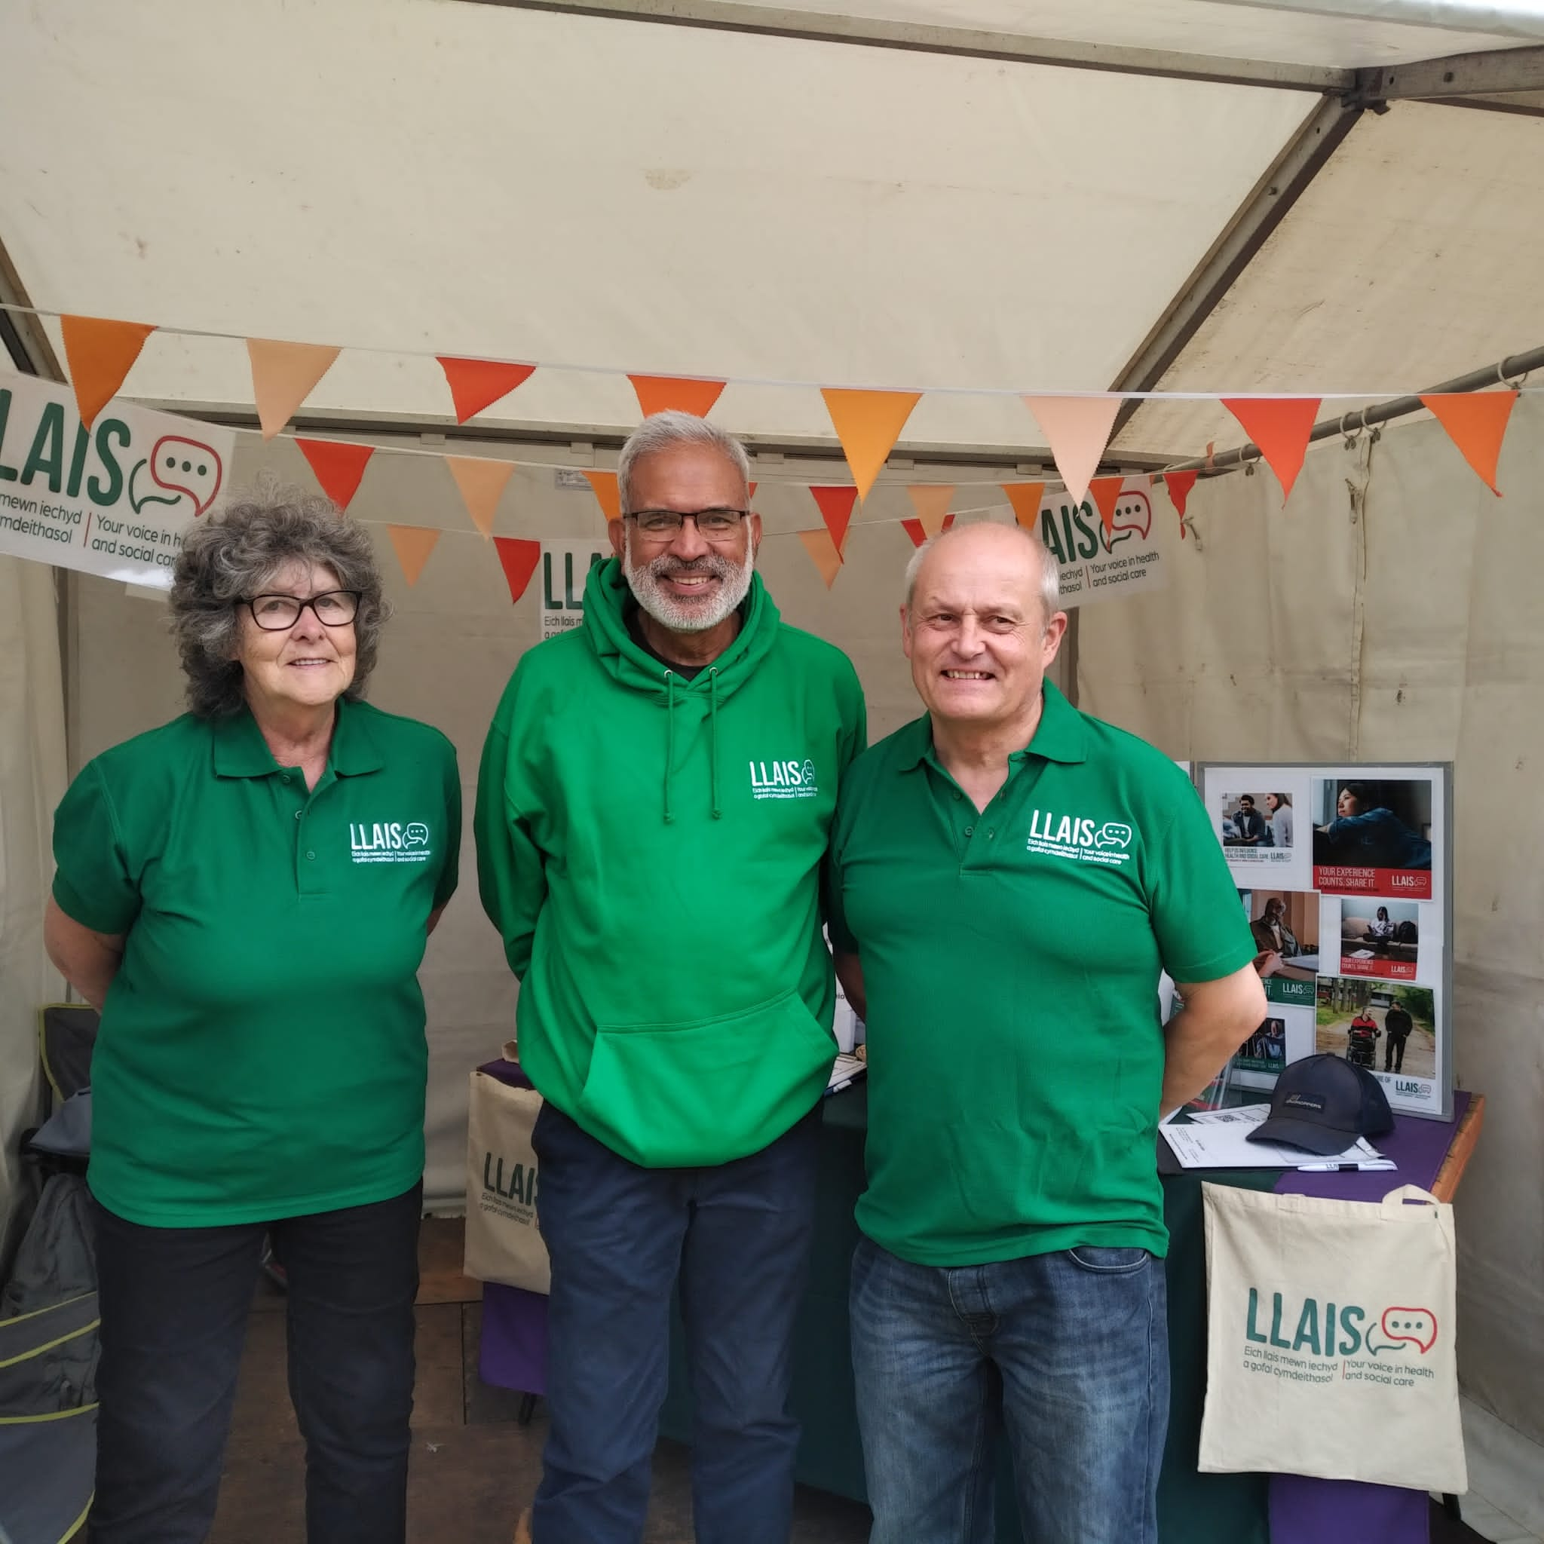
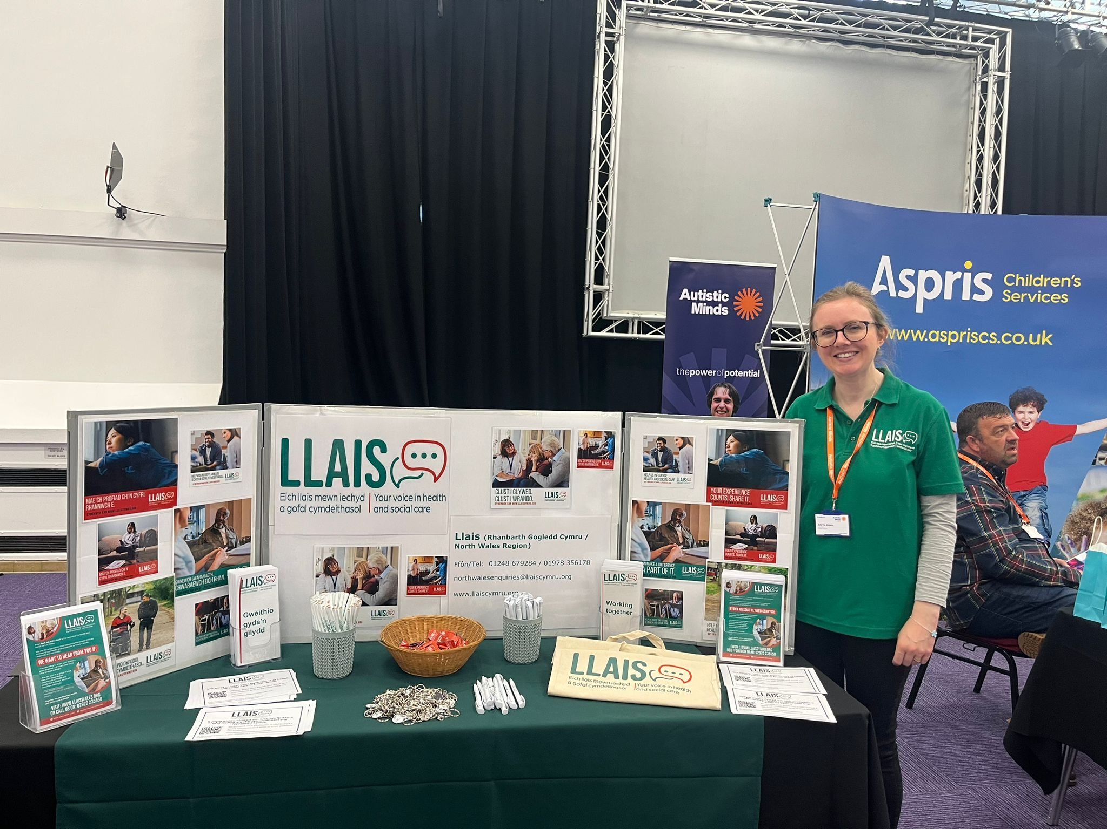
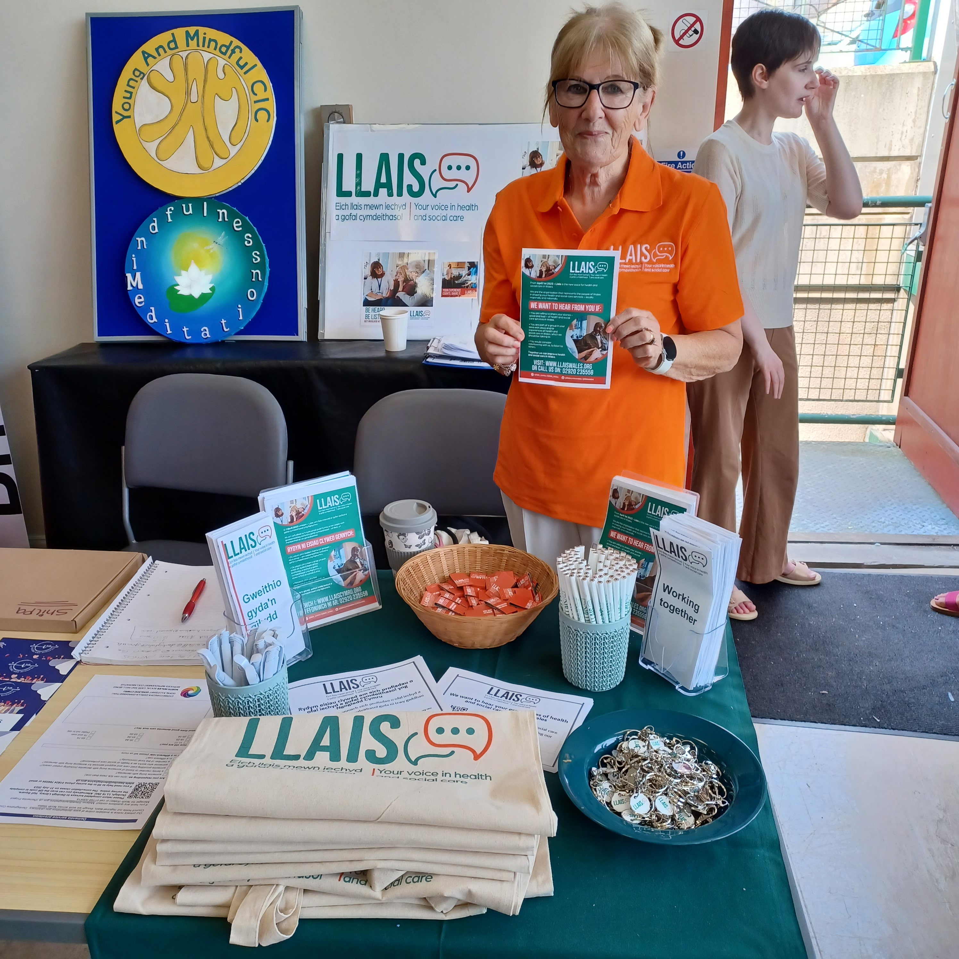
Engagement
North Wales has had a very active engagement programme, this includes attendance at events such a Flintshire Pride, National and International Eisteddfods as well as our subject-specific Safe Space events, these have included;
Speech & Language Therapy
Menopause
Waiting Times
Vascular Services

